Slide 1
Describing Semantics
CMSC 330: Programming Languages

Slide 2
Semantics
The meaning of expressions, statements, and other program units
Why care? So we …
  Can write a language processor
  Understand the precise behavior of every construct
  Prove program correctness

Slide 3
Categories of Semantics
Operational Semantics
Denotational Semantics
Axiomatic Semantics

Slide 4
Operational Semantics
Defines the meaning of a program by specifying how execution proceeds step by step
Uses an abstract machine (not necessarily a real or implemented VM)
Meaning is given by changes in the program’s state (environment, memory, store, etc.)
For high-level languages, an abstract “virtual machine” is typically defined
A simple example of small-step operational semantics is λ-calculus reduction, which will be covered later

Slide 5
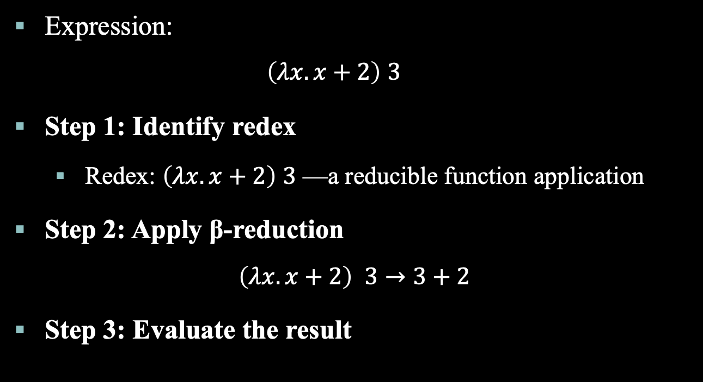
Operational Semantics: Examples
Expression:
  $$\left(λx.x+2\right) 3$$
Step 1: Identify redex
  Redex: $\left(λx.x+2\right) 3$— a reducible function application
Step 2: Apply β-reduction
$$\left(λx.x+2\right) 3→3+2$$
Step 3: Evaluate the result

Slide 6
Operational Semantics: Examples
High-level loop:
  for (expr1; expr2; expr3) { … }
Equivalent step-by-step abstract execution:
  expr1
  loop:
  if not expr2 goto out
  …
  expr3
  goto loop
  out: …

Slide 7
Uses of Operational Semantics
Language manuals and textbooks
Teaching programming languages
Can be extremely complex to use formally

Slide 8
Denotational Semantics
Based on Recursion Theory
Provides the most abstract description of program meaning
Building a denotational specification:
  Associate a mathematical object with each language construct
  Define a function mapping language constructs to these objects
Key idea: meaning of constructs depends only on the values of program variables (and not on step-by-step execution)

Slide 9
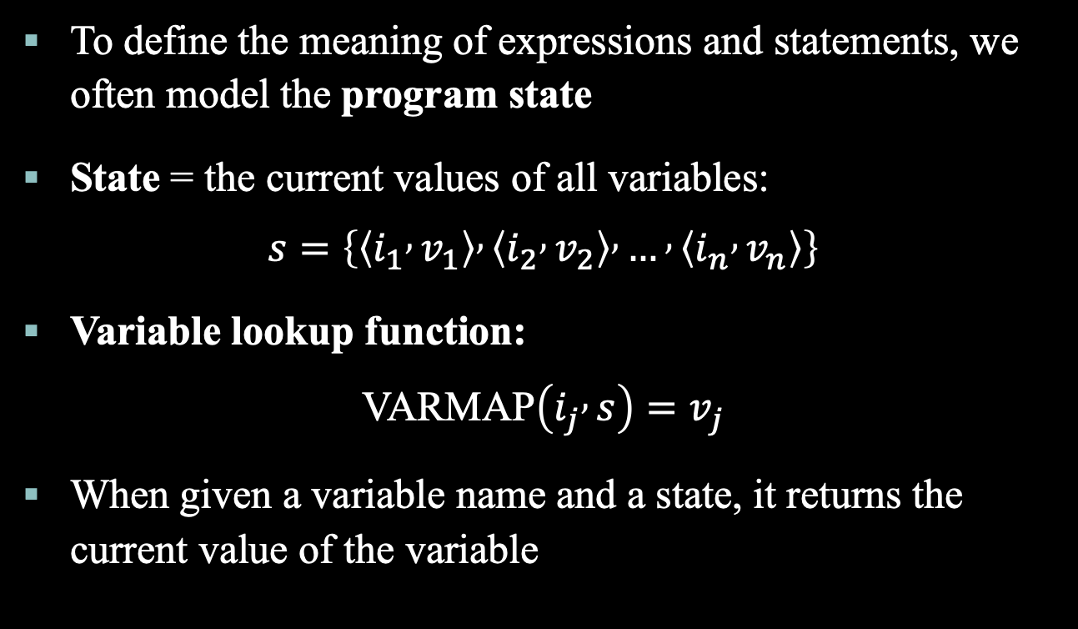
Program State
To define the meaning of expressions and statements, we often model the program state
State = the current values of all variables:
$$s=\left\{\left\langle i_{1} , v_{1}\right\rangle , \left\langle i_{2} , v_{2}\right\rangle , … , \left\langle i_{n} , v_{n}\right\rangle \right\}$$
Variable lookup function:
$$\text{VARMAP}\left(i_{j} , s\right)=v_{j}$$
When given a variable name and a state, it returns the current value of the variable

Slide 10
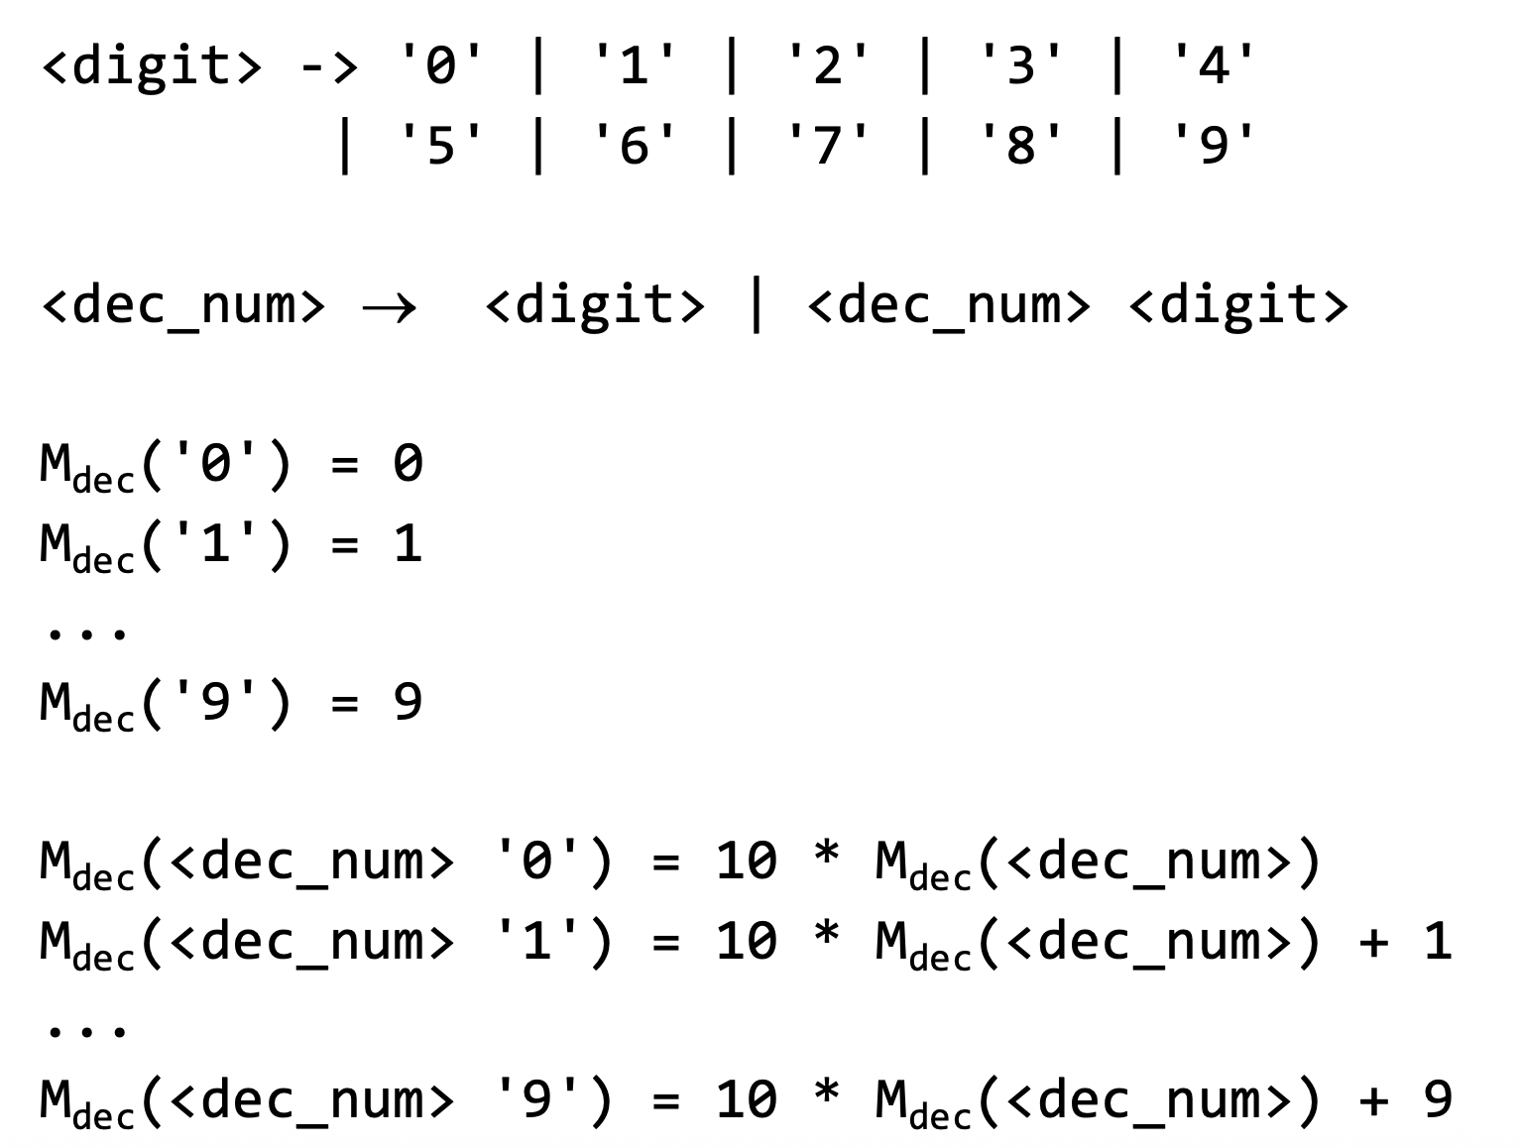
Denotational Semantics: Examples

Slide 11
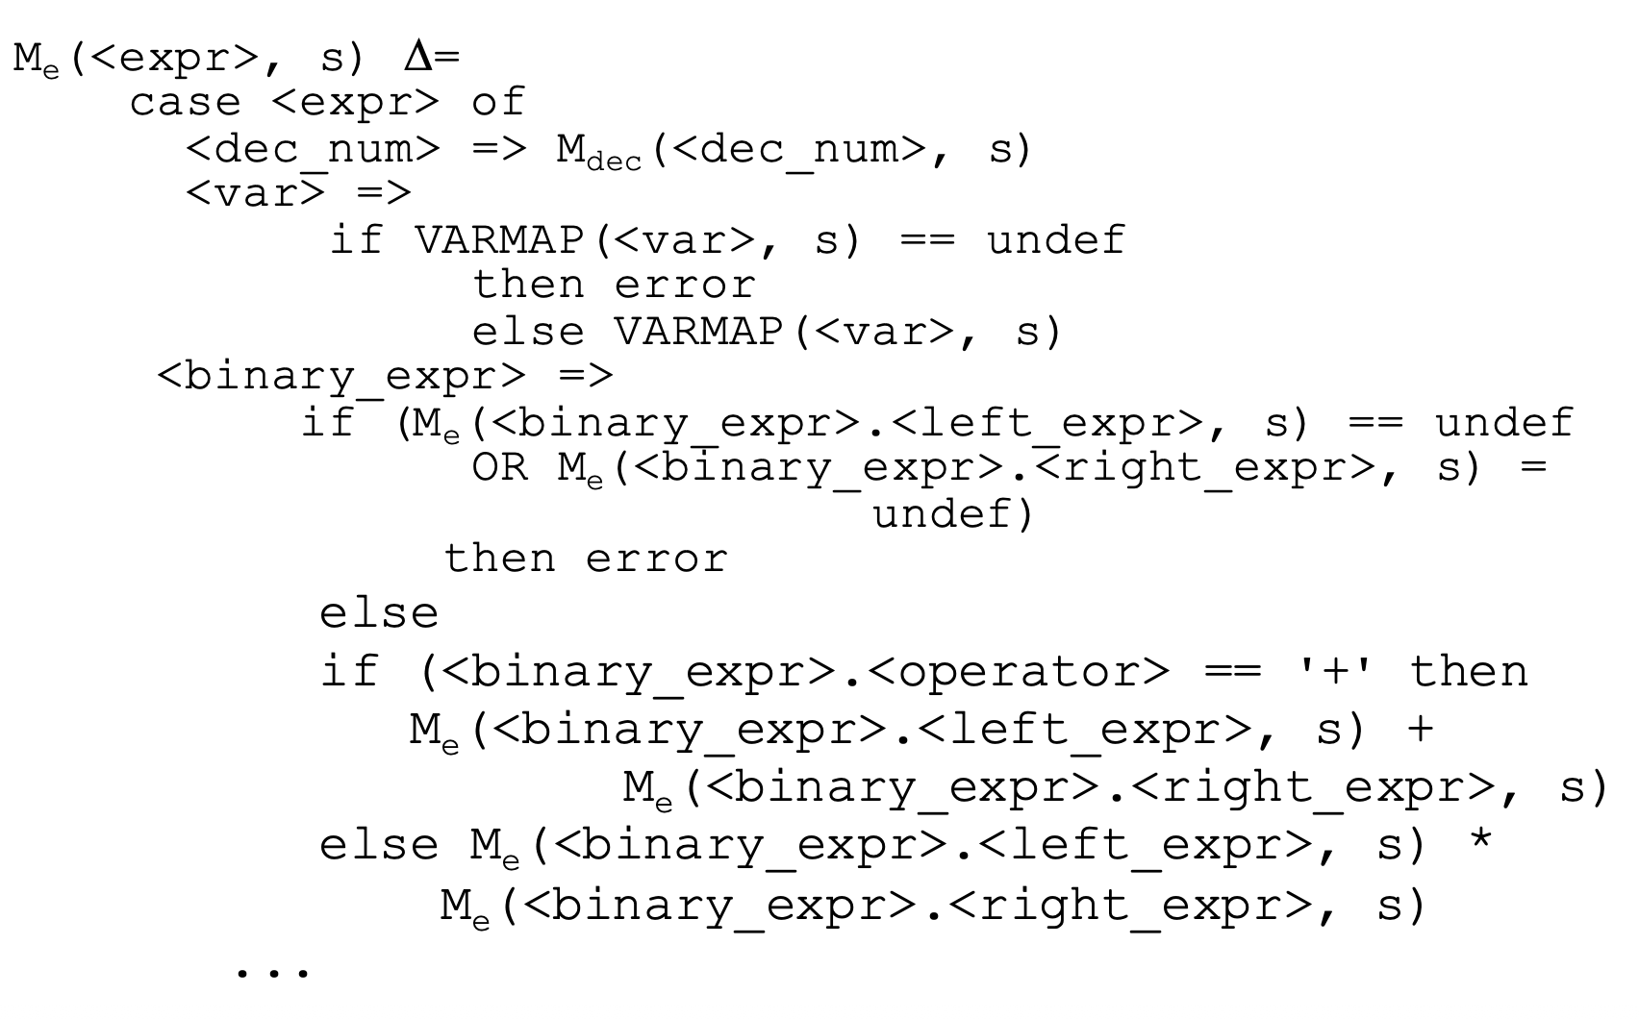
Denotational Semantics: Examples

Slide 12

Denotational Semantics: Examples
Consider this recursive method: f(n) =$\left\{\begin{aligned}1 ,n = 0 \\ n* f(n-1) ,n>0\end{aligned}\right.$
But this assumes f already exists which is not allowed in denotational semantics
We define a function F on functions:
  F$\left(f\right) (n)=\left\{\begin{aligned}1 , x=0 \\ &n*f(n-1), x>0\end{aligned}\right.$
Fixed point (FP): A value 𝑥such that 𝐹(𝑥)=𝑥
Then, the meaning of the recursive method is the least fixed point of F, e.g., the function f such that f = F(f)

Slide 13
Operational vs. Denotational
In operational semantics, the state changes are defined by coded algorithms
In denotational semantics, the state changes are defined by rigorous mathematical functions

Slide 14
Axiomatic Semantics
Based on formal logic (predicate calculus)
The original purpose is formal program verification
Inference rules show how to determine what must be true before a statement so that a desired property holds afterward
These logical statements about program state are called assertions
Covered in a later chapter

Slide 15
Attribute Grammars
A formal method to attach meaning to syntax
Extends a context-free grammar with attributes and semantic rules
Attributes: values associated with grammar symbols (e.g., type, value, scope)
Semantic rules: define how attributes are computed based on other attributes

Slide 16
Attribute Grammars
Attribute grammars describe a subset of semantics: mainly static semantics (compile-time properties)
Not part of the 3 classical categories (operational, denotational, axiomatic), which focus on program execution and runtime behavior
Key idea: Attribute grammars are directly tied to syntax and can compute types, scopes, and intermediate representations during compilation
Directly useful for compiler design

Slide 17
Attribute Grammars
Review: a context-free grammar has a start symbol, non-terminals, terminals, production rules (e.g., Expr → Expr + Term)
An attribute grammar adds information to this grammar
Attributes: each grammar symbol (terminal or non-terminal) has a set of attributes (e.g., Term.type)
Semantic rules: each production rule has functions defining attribute values (e.g., Expr.value = Expr1.value + Term.value)
Predicates: optional Boolean conditions to ensure consistency (Expr1.type == Term.type)

Slide 18
Types of Attributes
Synthesized Attributes
  Values are computed from children to parent (bottom-up)
  Number → '7'
  Number.value = 7
Inherited Attributes
  Values are passed from parent to children (top-down)
  Expr → '(' Expr ')'
  Expr2.expectedType = Expr.expectedType
Intrinsic Attributes
  Static information attached to TERMINALS

Slide 19
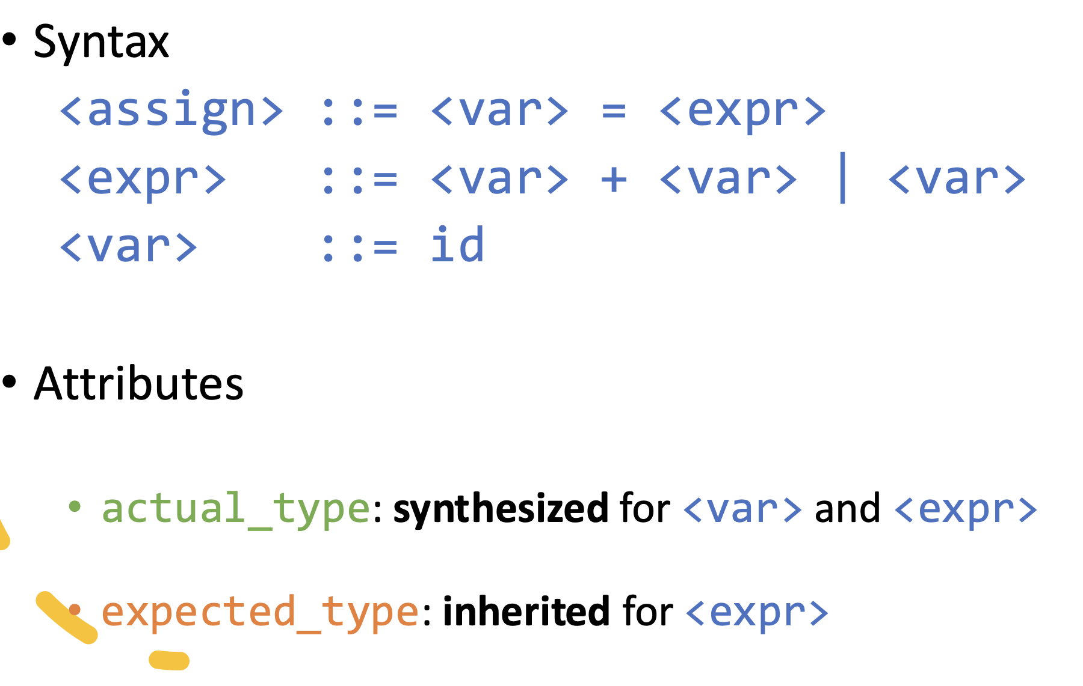
Attribute Grammars: Examples

Slide 20
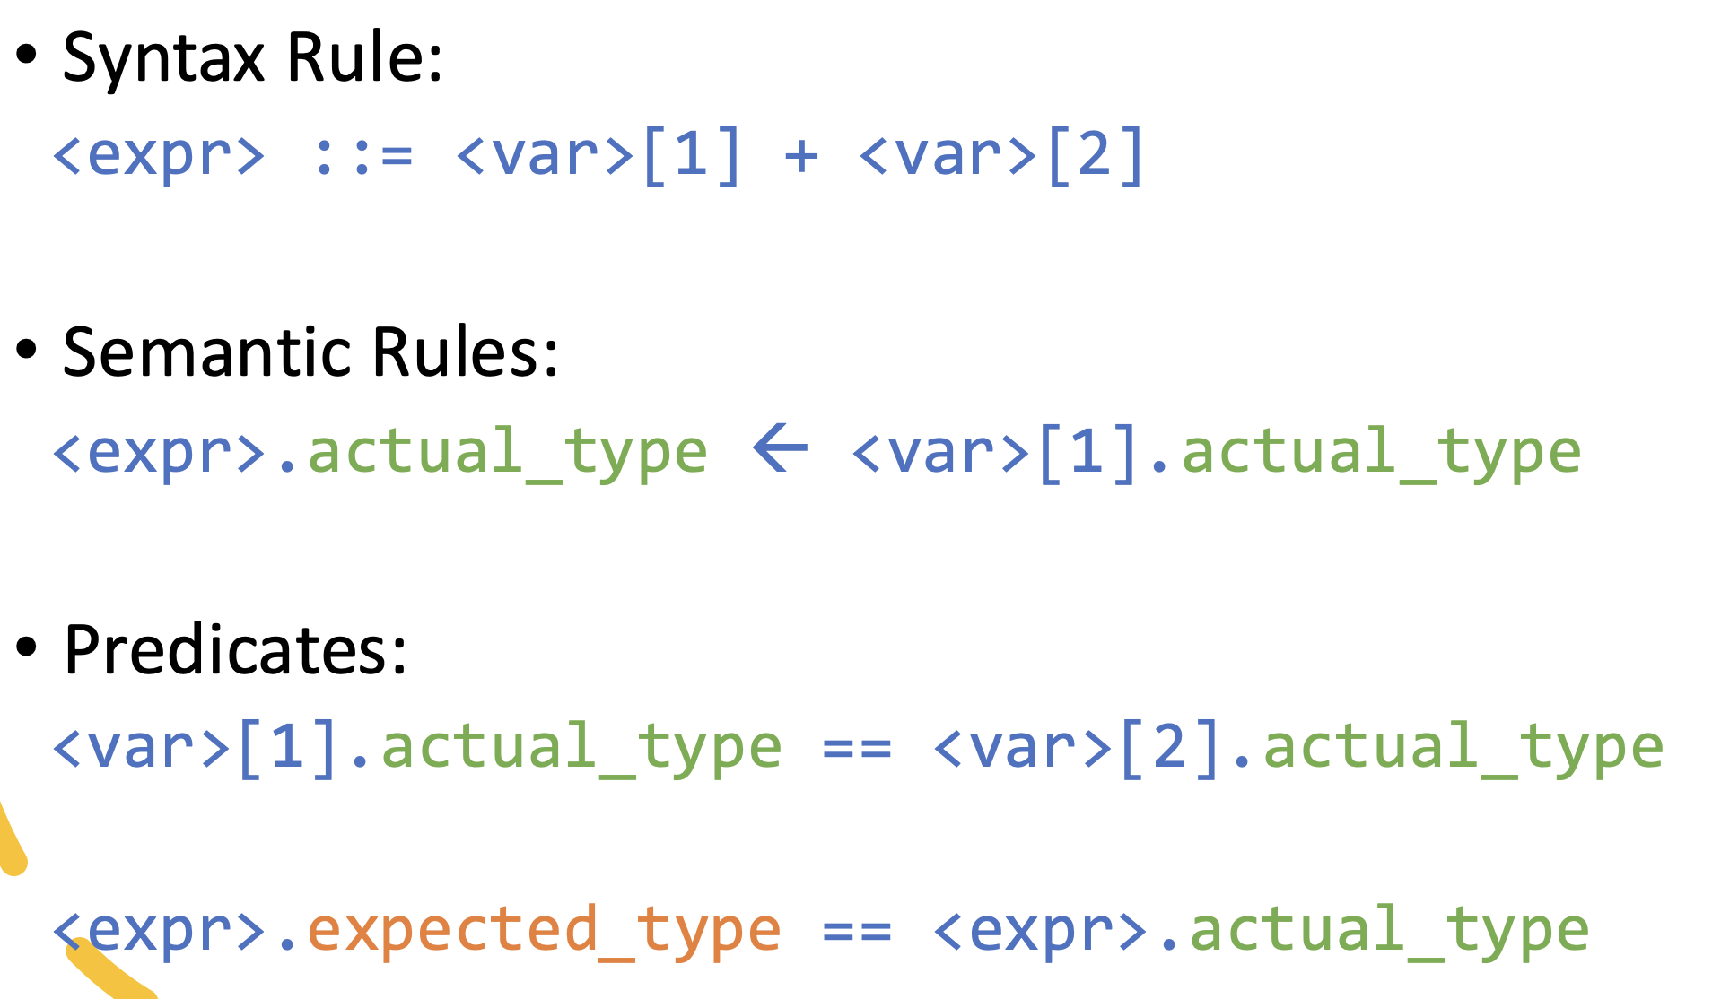
Attribute Grammars: Examples

Slide 21
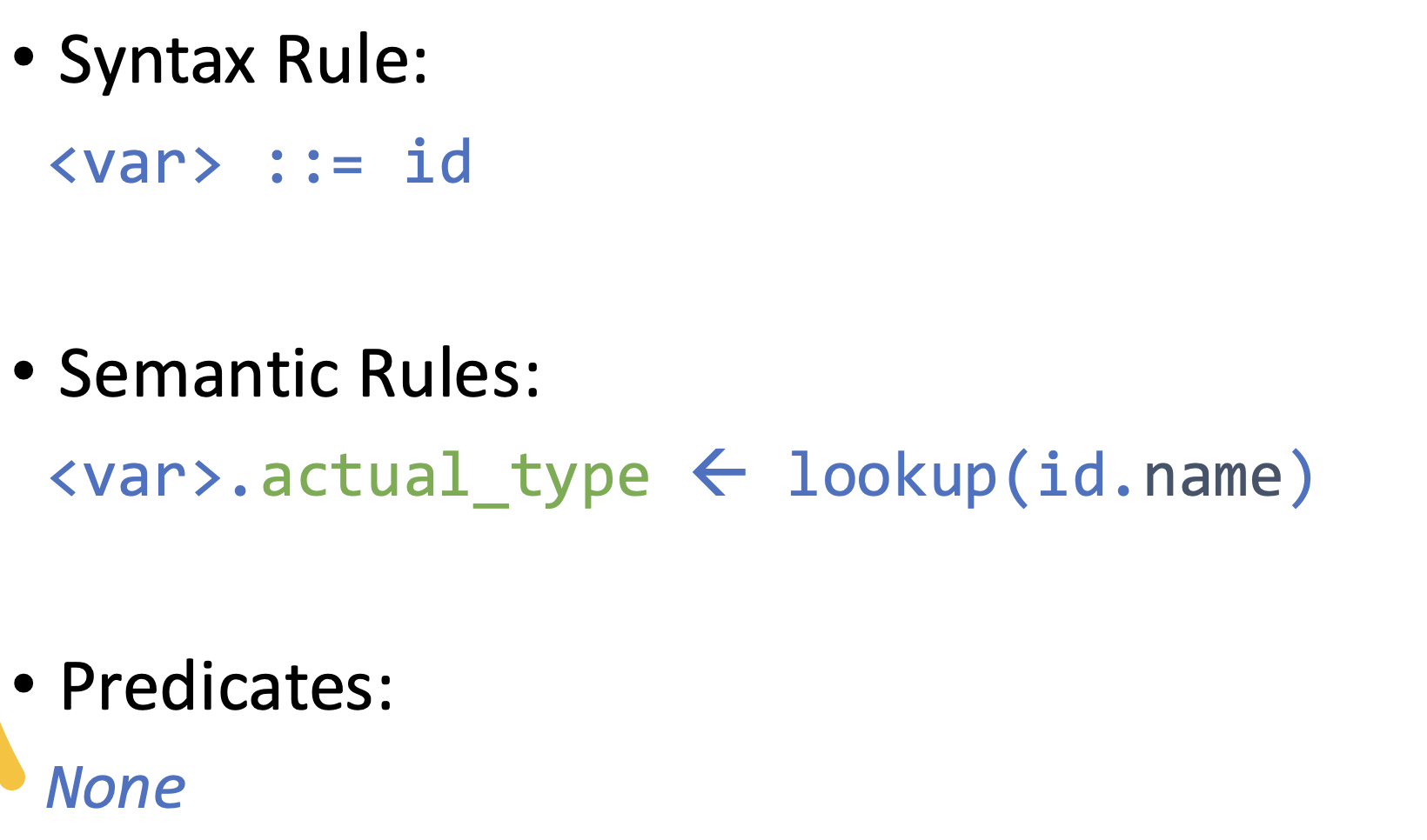
Attribute Grammars: Examples

Slide 22
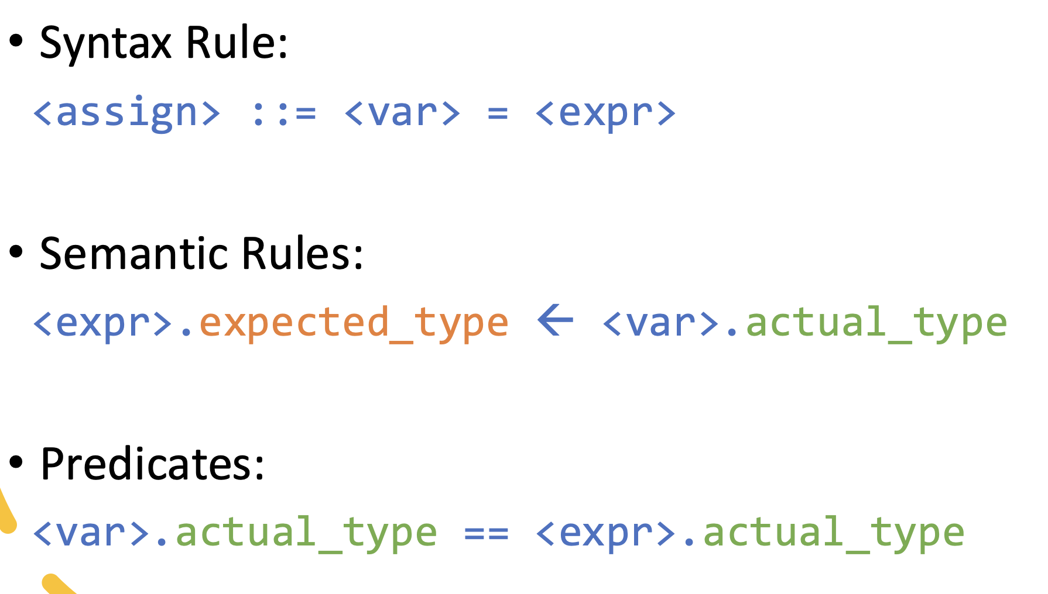
Attribute Grammars: Examples
Notes:
<expr>.expected_type is inherited from <var>.actual_type
var actual type is the first to get by a compiler

Slide 23
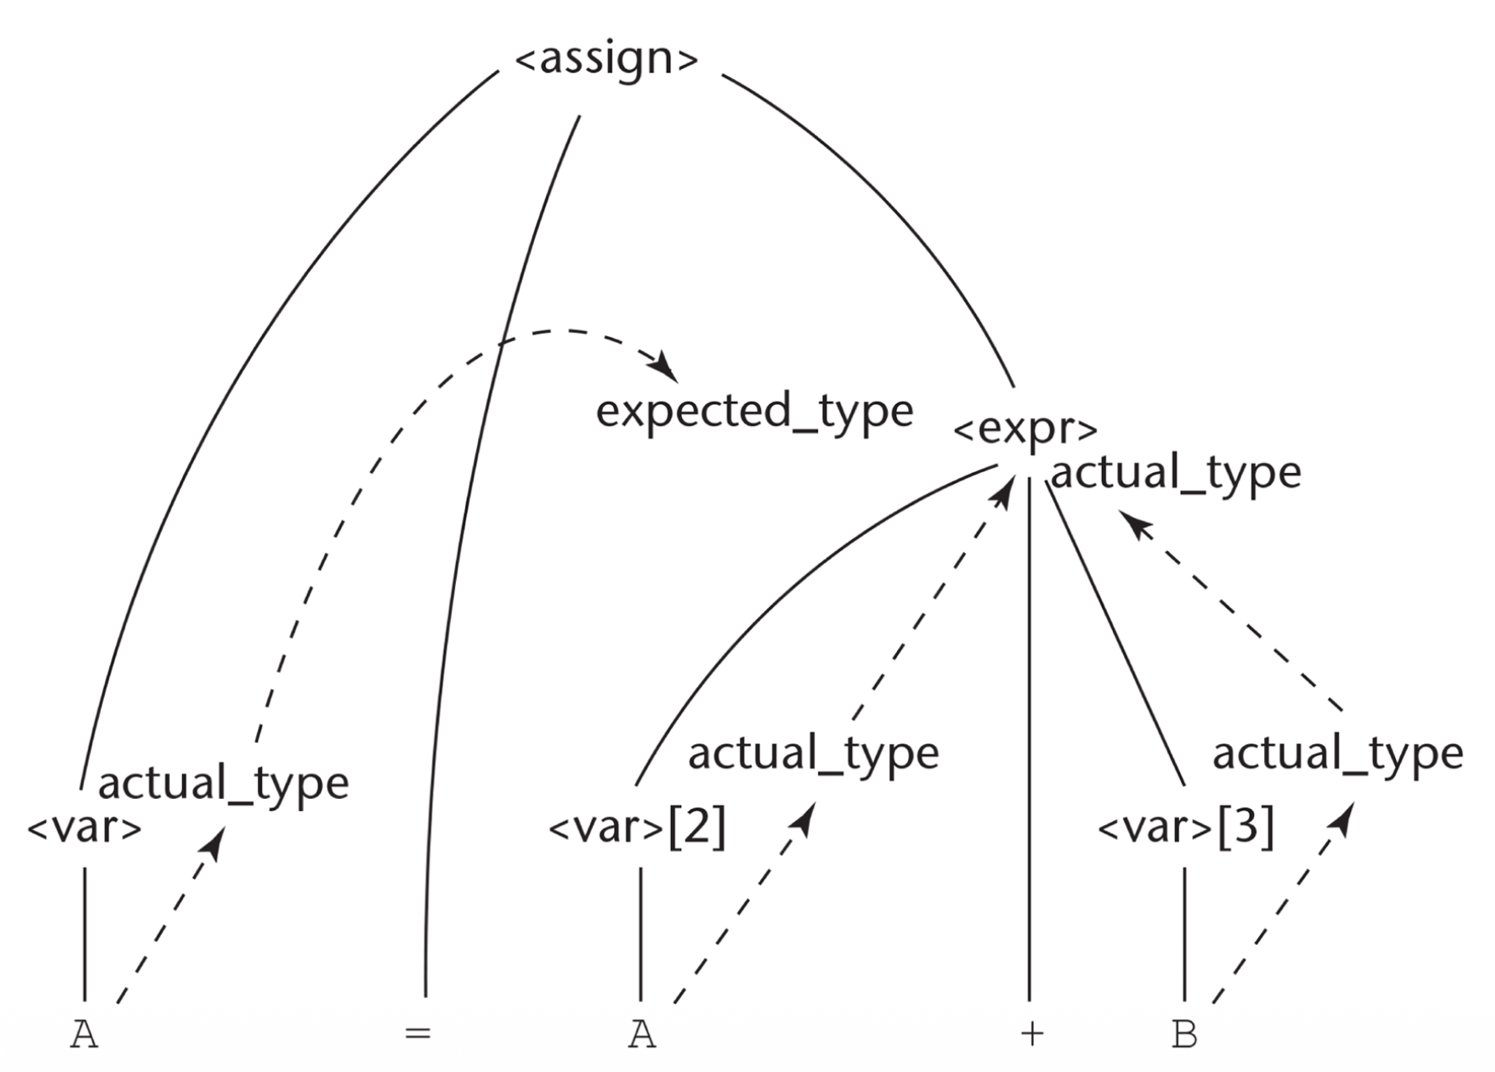
Attribute Computation

Slide 24
Attribute Grammars: More Examples
Suppose we have the following code:
  z = x + y, where
x is an int
y is an int
z is a string

Slide 25
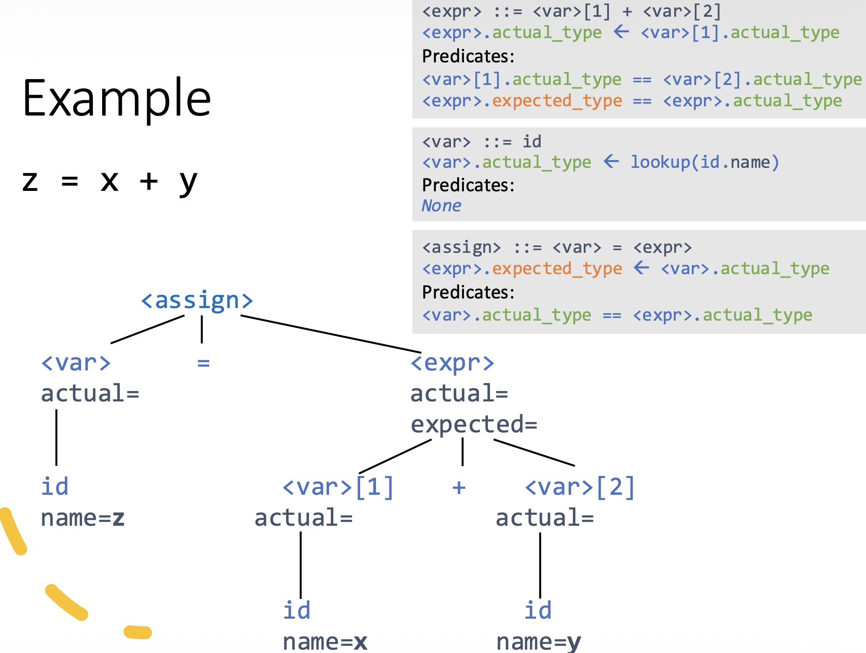
Attribute Grammars: More Examples

Slide 26
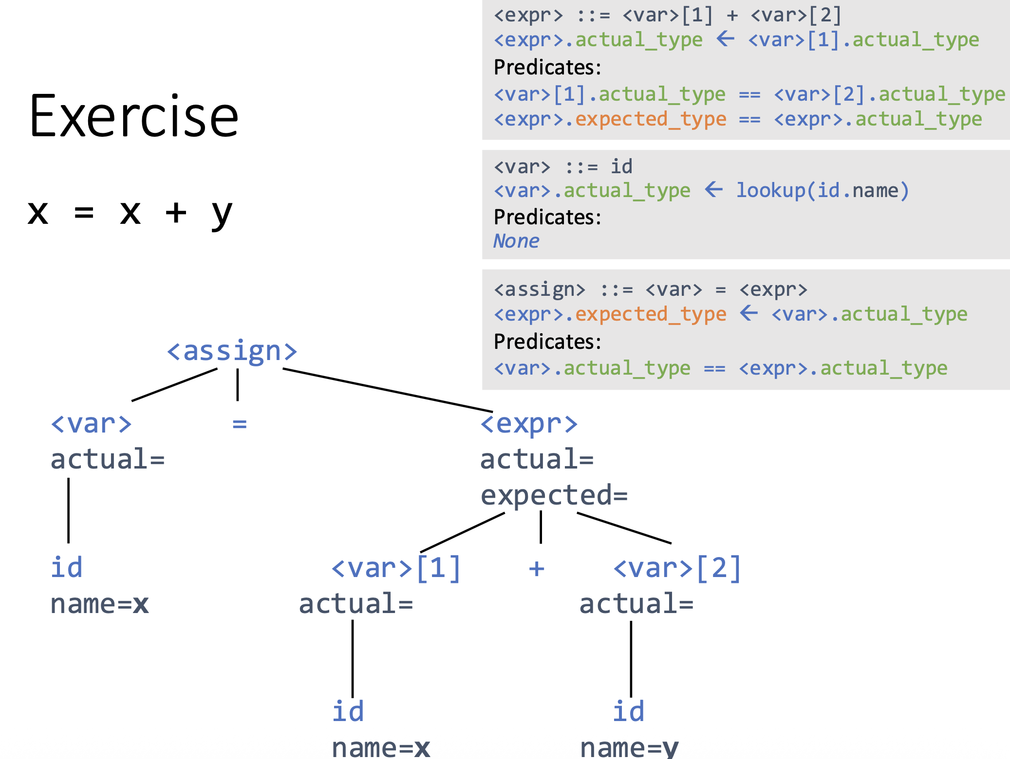
Attribute Grammars: More Examples

Slide 27
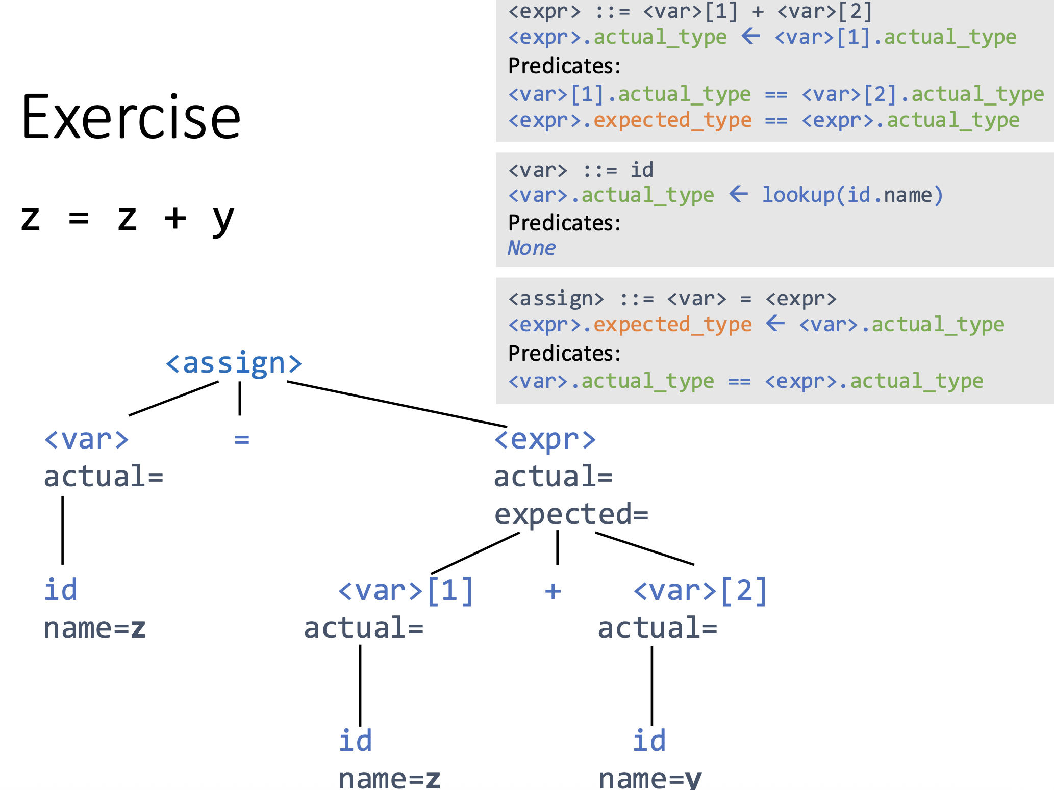
Attribute Grammars: More Examples

